Slide 1


MENTORNESS PROJECT
ON
EXPLORING ACCOMMODATION LANDSCAPES
BY
RICHARD AKINWARE

Slide 2

Introduction:
Our hotel aggregator listings your one-stop destination for discovering a diverse array of accommodations worldwide. Whether you're planning a luxurious getaway, a budget-friendly stay, or a cozy retreat, our platform offers a comprehensive selection of hotels, resorts, guesthouses, and vacation rentals to suit every preference and budget. With user-friendly search filters and detailed listings, finding the perfect accommodation has never been easier. Explore a world of possibilities and book with confidence, knowing that our aggregator brings together the best options from trusted sources, ensuring a seamless and satisfying booking experience for every traveler.

Slide 3

PROBLEM STATEMENT
The dataset comprises various attributes related to listings,hosts, reviews, and availability.
The objective is to create comprehensive visualizations
and insights that shed light on trends, patterns,
and factors influencing the performance of listings.

Slide 4
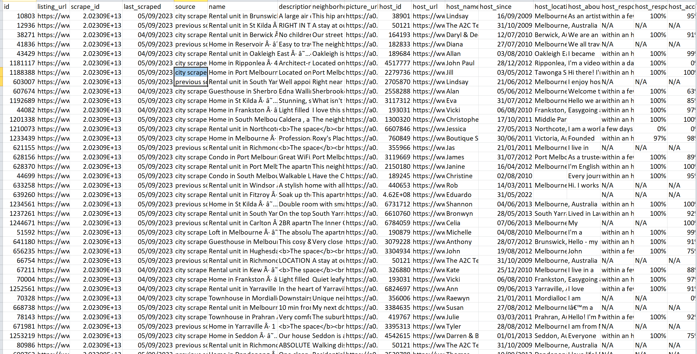
UNCLEAN DATA

Slide 5
DATA CLEANING PROCESS
1. Handling Missing Values
2. Dealing with Duplicates
3. Standardizing Data Formats
4. Handling Outliers
5. Addressing Inconsistencies

Slide 6
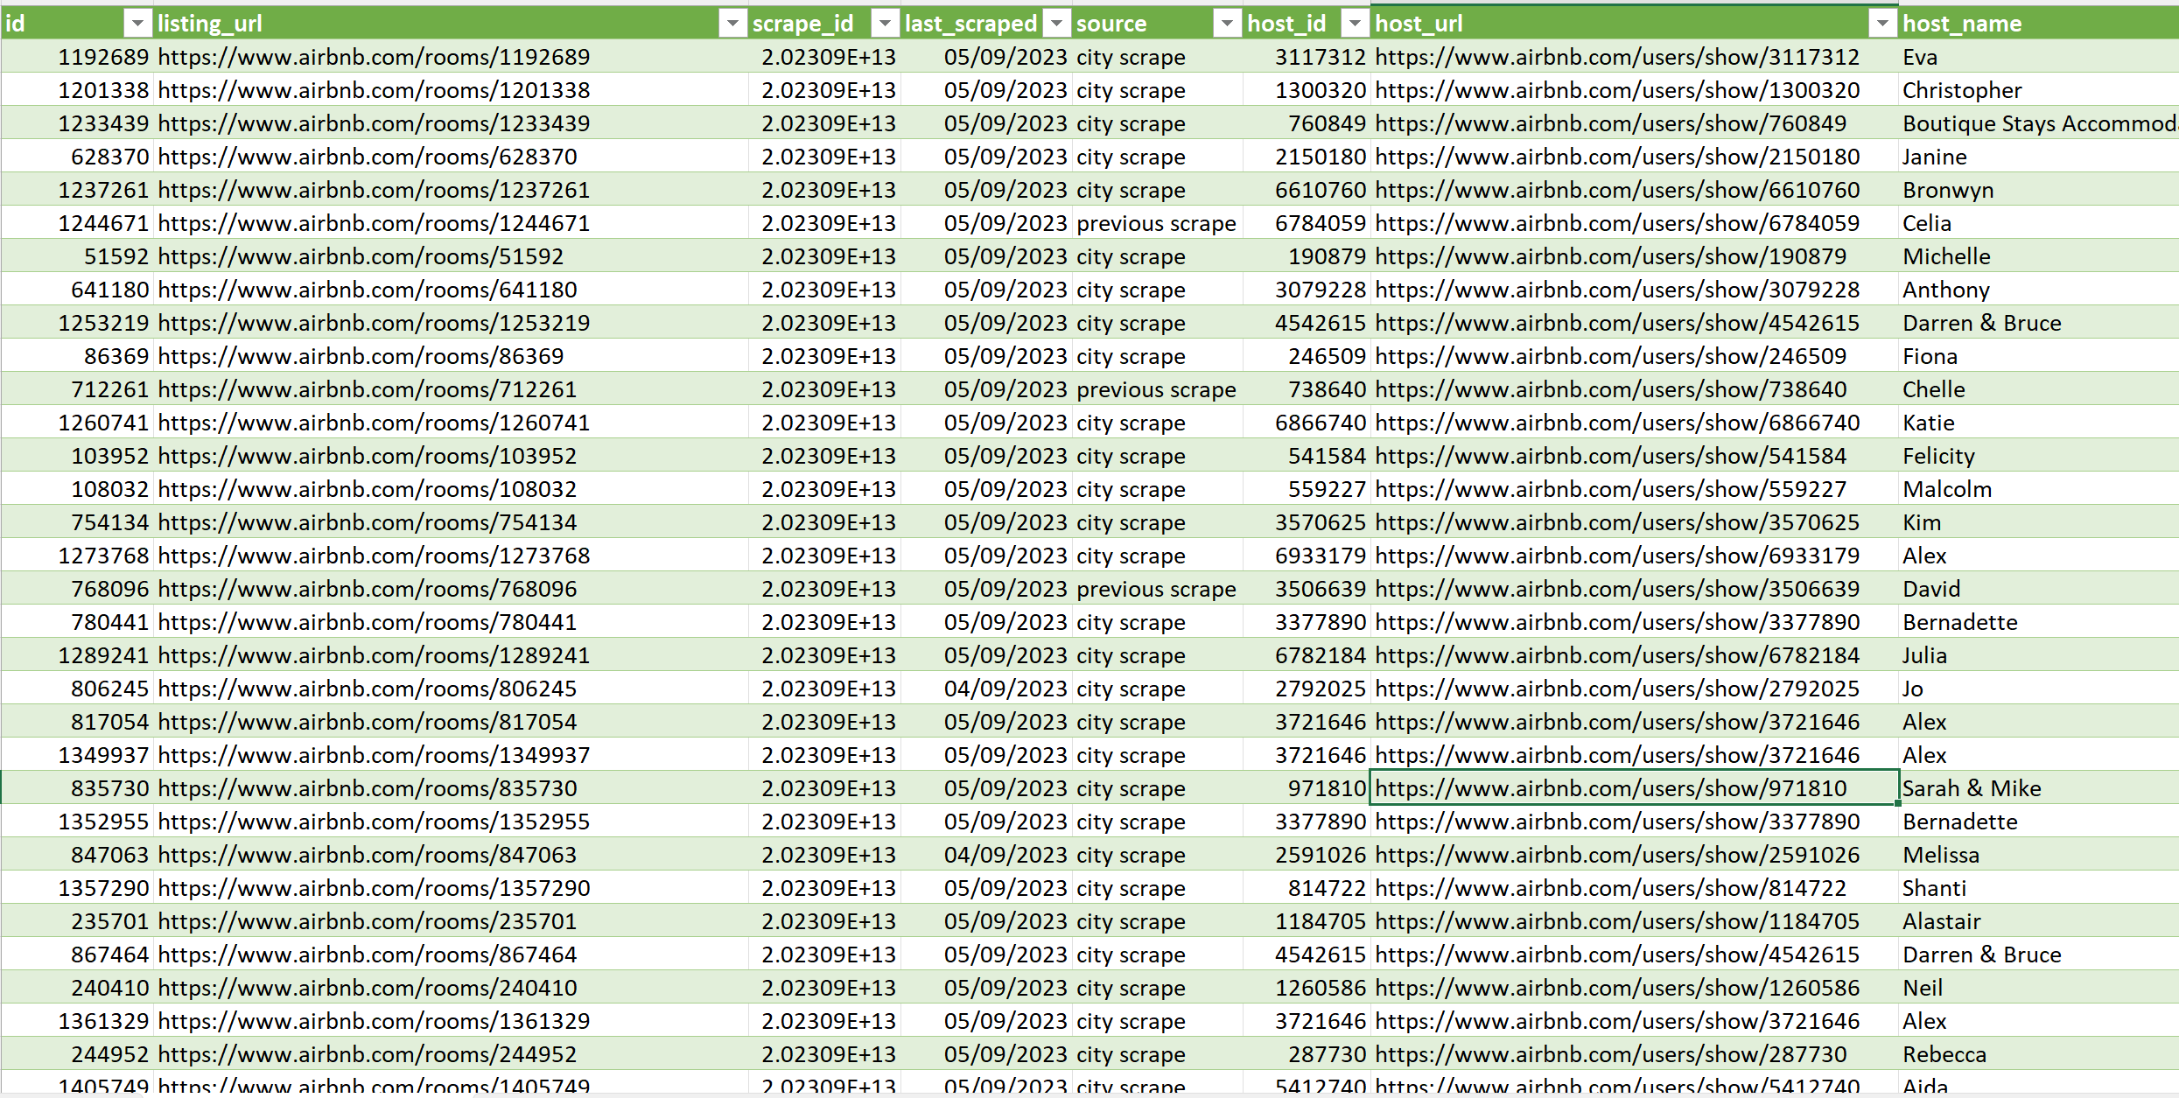
CLEAN DATA

Slide 7
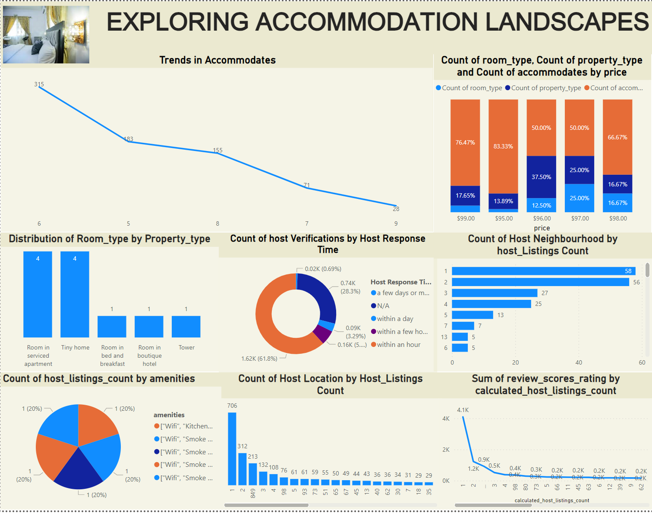
DASHBOARD

Slide 8
RECOMMENDATION
1. Social media promotion: hosts can actively promote their properties on social media platforms, leveraging targeted advertising campaigns to reach potential guests within specific demographics or geographic regions. Sharing captivating visuals, compelling descriptions, and limited-time offers can help generate interest and drive bookings in a shorter time frame.
2. Instant booking options: enable instant booking options for properties to streamline the reservation process and cater to guests who prefer immediate confirmation. This can lead to a higher conversion rate and faster responses to booking inquiries.
3. Enhanced advertising campaigns: increase advertising efforts through targeted online ads, social media promotions, and partnerships with travel influencers or agencies. Allocate resources to strategic advertising channels that have a proven track record of driving traffic and conversions within a short time frame.
4. Time-Sensitive Promotions: Introduce time-sensitive promotions and discounts exclusively for bookings made within a short window of time, such as within the next hour. Prominently display these limited-time offers on the platform to create a sense of urgency and prompt users to take immediate action.

Slide 9
CONCLUSION
In Conclusion, Hotel Aggregator Listings Offer Travelers A Convenient And Efficient Way To Discover And Book Accommodations That Suit Their Preferences And Budget. With A Wide Range Of Options From Various Sources Consolidated Into One Platform, Users Can Easily Compare Prices, Amenities, And Reviews To Make Informed Decisions. Whether Planning A Spontaneous Getaway Or A Meticulously Planned Vacation, Hotel Aggregators Simplify The Booking Process, Saving Time And Ensuring A Seamless Travel Experience. Say Goodbye To Endless Searching And Hello To Effortless Booking With Hotel Aggregator Listings.
Happy Travels!

Slide 10
THANK YOU

